Slide 1
Churches in east slovakia
Jaro Fedor
Denis Tirpák
II.E

Slide 2
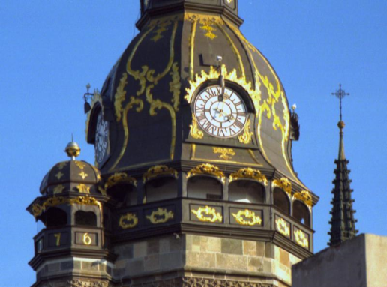
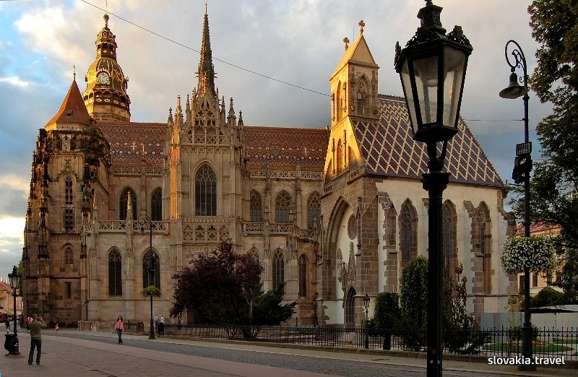
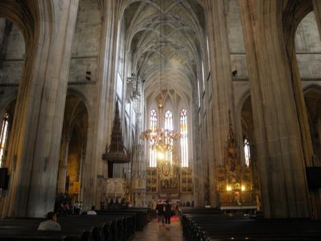
Cathedral of St. Elizabeth
Where? Košice
Structure Gothic
Completion 1508
Parish Parish of St. Elizabeth
Video

Slide 3
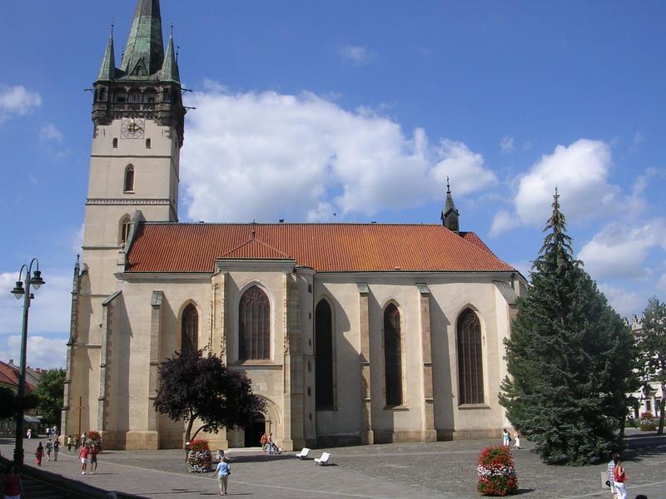
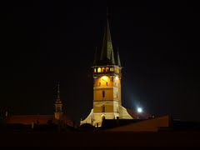
Cathedral of St. Nicholas
Where? Prešov
Built 14th century
Structure Gothic
Parish Parish of St. Nicholas

Slide 4
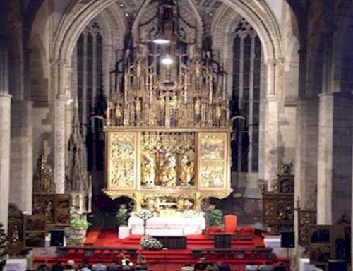
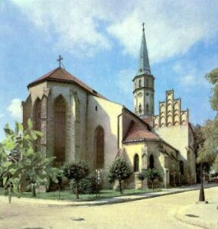
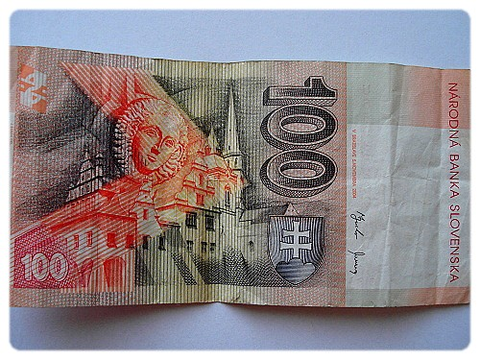
St. jakub Cathedral
Where? Levoča
Built 14th century
Structure Gothic
Parish Parish of Levoča

Slide 5
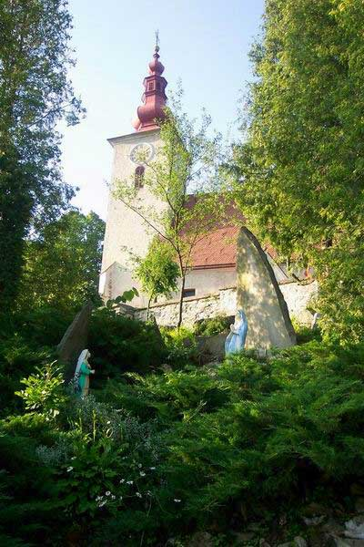
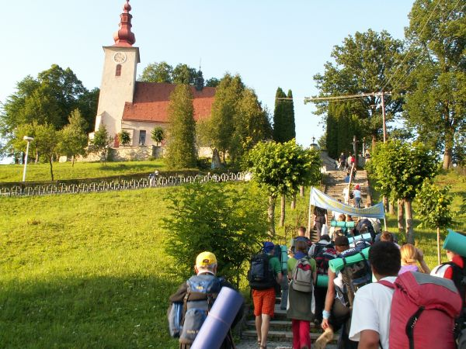
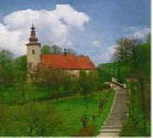
Church of st. Vojtech
Where? Gaboltov
Built 14th century
Structure Early Gothic
Parish Parish of Gaboltov

Slide 6
The end
Thank you for your attention

